Slide 1



NEXT GEN EMPLOYABILITY PROGRAM
Creating a future-ready workforce
College Name : JP COLLEGE OF ENGINEERING
Student Name : SHAM SURESH S
Student ID :au951221104050

Slide 2
CAPSTONE PROJECT SHOWCASE
PROJECT TITLE : Voting Web Application using Django Framework
Abstract
Problem Statement
Project Overview
Proposed Solution|
Technology Used
Modelling & Results
Conclusion

Slide 3
Abstract
This project introduces a voting application, a user-friendly voting application built on the Django framework.
Designed to streamline the voting process, this application offers a straightforward interface for voters to cast their ballots securely from anywhere.
Leveraging Django's capabilities, the application ensures smooth authentication, efficient database management, and dynamic web functionality.
Administrators can easily oversee elections, monitor voter activity, and generate insightful reports. With a focus on user accessibility and data security.

Slide 4
Problem Statement
The traditional methods of voting, like paper ballots or in-person voting, present challenges such as accessibility issues for people with disabilities, geographical constraints, and concerns about security and efficiency. Moreover, the COVID-19 pandemic highlighted the need for remote voting options to ensure public safety during elections.
Usability: The success of the application depends on its ease of use. It should guide users through the voting process clearly and provide helpful feedback to prevent errors.
Scalability: The application needs to handle a large number of users and concurrent voting sessions without performance issues. It should also support various types of elections.
By addressing these challenges, the voting web application aims to modernize voting, encourage democratic participation, and uphold transparency and fairness in elections.
With a user-friendly interface accessible to all, stringent security measures ensuring the integrity of the process, and scalability to handle large volumes of users, the application aims to overcome the limitations of traditional voting methods. Ultimately, this project strives to enhance the democratic process by making voting more convenient, inclusive, and trustworthy for citizens.

Slide 5
Project Overview
The Simple Polling System is designed to facilitate quick and engaging polls on various topics, such as determining the fastest animal. Users can participate by voting for their preferred option as many times as they like. The system features a dynamic web interface built using Django, allowing users to easily access and interact with the polls from any device with an internet connection.
Poll Creation: Administrators can create new polls with multiple options, including the question "Which is the faster animal?" and choices like "Cheetah," "Peregrine Falcon," "Sailfish," etc.
User Participation: Users can vote for their preferred option by simply selecting it from the list of choices. They have the flexibility to cast their vote multiple times if desired.
Real-time Vote Tally: The system provides real-time updates on the number of votes each option receives, allowing users to see which animal is currently leading in the poll.

Slide 6
Proposed Solution
.
The Simple Polling System will be developed using Django, featuring a user-friendly web interface for conducting polls on topics like the fastest animal.
Administrators can create, edit, and delete polls via the Django admin panel. Users can vote multiple times for their preferred option without restrictions.
Real-time vote tallies will be displayed, with dedicated pages showcasing the option with the highest and minimum votes. Security measures will include protection against SQL injection and CSRF attacks.
By leveraging Django's features, the system will offer scalability, security, and simplicity, fostering user engagement and providing valuable insights into popular opinions.

Slide 7
User Engagement: The system encourages active participation through its intuitive interface and repeat voting feature, fostering engagement and interaction among users.
Real-time Insights: Users can see real-time updates on vote tallies, providing immediate insights into popular opinions and preferences on various topics.
Scalability: Built on the Django framework, the system is scalable and can accommodate a growing number of users and polls without compromising performance.
Ease of Use: Both administrators and users benefit from the system's user-friendly interface and straightforward functionality, enhancing usability and accessibility.
Flexibility: Administrators have the flexibility to create, edit, and delete polls as needed, allowing for customization and adaptation to changing requirements or topics of interest

Slide 8
Vulnerability to Manipulation: Lack of restrictions on repeat voting may lead to manipulation or bias in poll results.
Limited Authentication: The system lacks user authentication, potentially allowing for impersonation or misuse.
Accuracy Concerns: Without measures to verify the identity of voters, the accuracy and reliability of poll results may be compromised.
Potential for Bias: User engagement may be skewed towards certain demographics or groups, resulting in biased outcomes.
Overwhelming Response: A high volume of repeat votes could overwhelm the system and skew results, impacting the credibility of the polls.

Slide 9


Technology Used

Slide 10
Modelling & Results
In developing a voting application using Django, meticulous attention is directed towards both modelling the underlying data structure and effectively presenting the voting results to users.
Through Django's model system, the application's data architecture is meticulously crafted, typically featuring models like Question and Choice to represent the polls and available choices.
Once users have participated in the voting process, conveying the results to them becomes paramount.
Leveraging Django's templating system, the application dynamically generates HTML templates that vividly present the voting outcomes in an intuitive and visually engaging manner.
Furthermore, the application may utilize charting libraries or custom visualization techniques to elucidate the distribution of votes across different options, offering users valuable insights into the voting process's outcome.
:

Slide 11
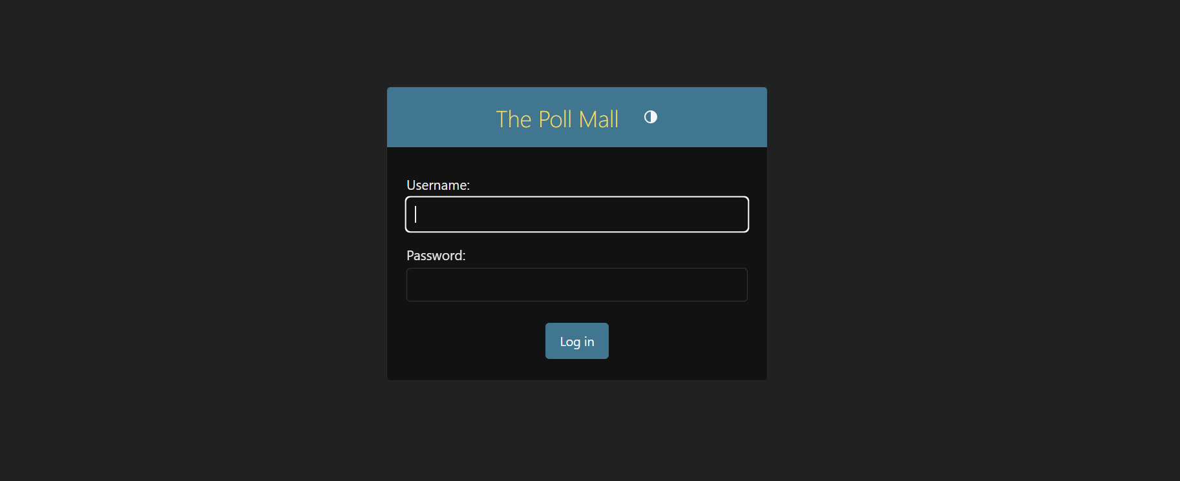
ADMIN PAGE

Slide 12
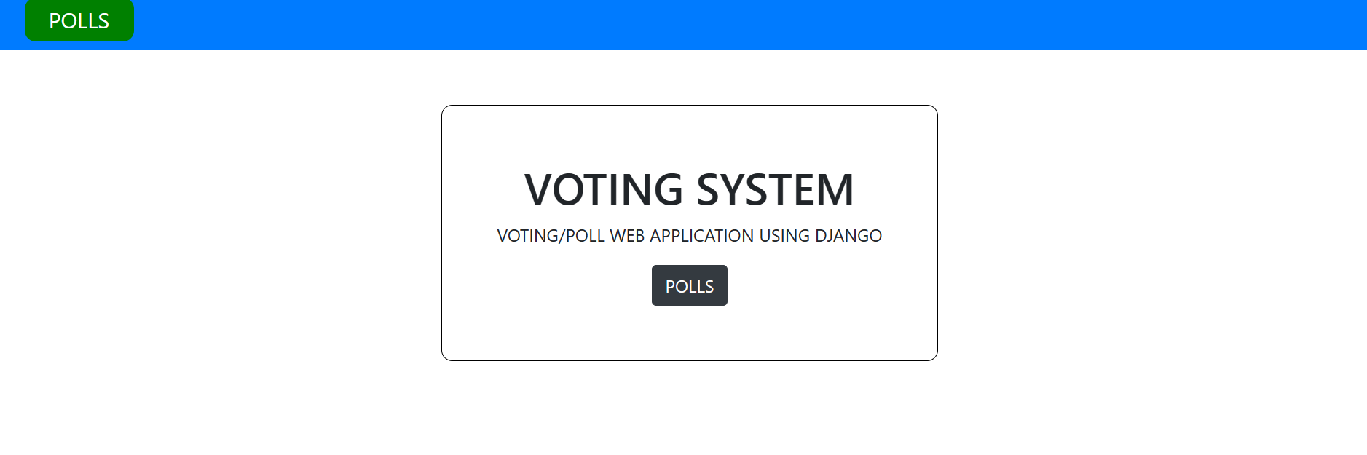
HOME PAGE

Slide 13


VOTING PAGES

Slide 14
About-Us-Page
1.Credibility:
The "About Us" page establishes credibility by providing information about the organization's history, mission, and team members
2.Mission and Values:
It communicates the organization's mission, values, and objectives in promoting democratic participation and decision-making.
3. Community Engagement:
The page showcases the organization's commitment to community engagement and empowerment through the voting process, inspiring active participation.
4. Contact Information:
Users can easily reach out with questions, feedback, or inquiries about the voting application through the contact information provided on the page.

Slide 15
Service-Page
1.Header Section
2.Introduction section
3.User Services
4.Administrator Services
5.Organizational Services
6.Technical Services
7.Consulting Services
8.Call to Action Services

Slide 16
Future Enhancements:
In the pursuit of advancing the voting application, several avenues for enhancement present themselves to enrich its functionality and user engagement.
One promising direction is the integration of advanced analytics tools, enabling administrators to glean deeper insights into voting behaviors, demographic trends, and predictive modeling for future electoral outcomes.
Furthermore, the incorporation of social media integration could amplify user engagement by allowing participants to share their voting activities and poll results seamlessly across popular platforms, fostering a wider reach and encouraging community involvement.
Real-time collaboration features offer another avenue for enhancement, empowering teams or committees to collaboratively create and refine polls, enhancing decision-making processes.

Slide 17
Conclusion
The Simple Polling System offers a convenient platform for conducting polls on various topics, promoting user engagement and providing valuable insights into popular opinions. While the system facilitates ease of use and real-time interaction, it also faces challenges such as vulnerability to manipulation, limited authentication, and potential biases in results. Despite these drawbacks, the system serves as a valuable tool for generating insights and fostering dialogue. Moving forward, implementing measures to enhance security, authentication, and data integrity will be essential to improving the credibility and reliability of poll results. By addressing these concerns, the Simple Polling System can continue to serve as a valuable resource for gathering public feedback and gauging sentiment on important issues.

Slide 18
THANK YOU

